Slide 1
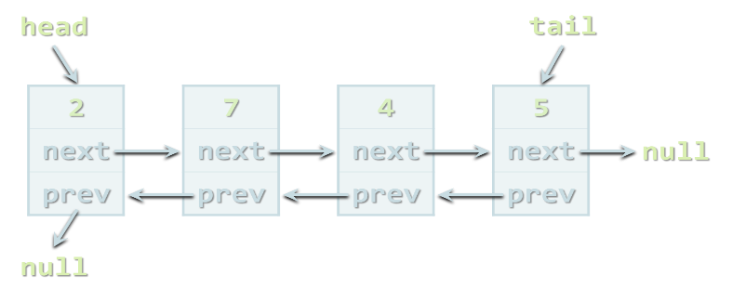



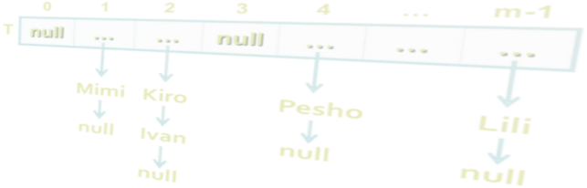
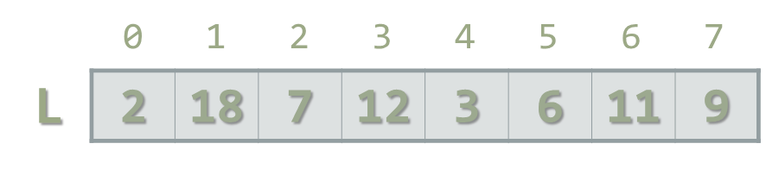

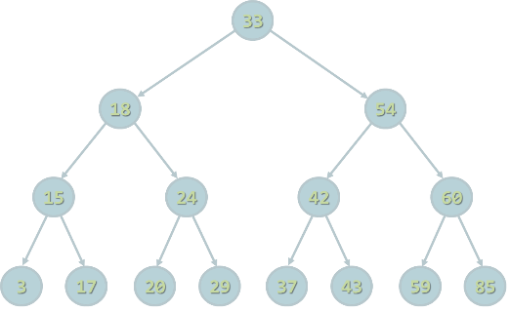
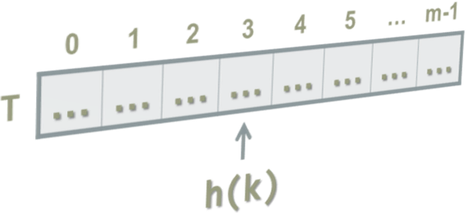
Java Collections Basics
Arrays, Lists, Strings, Sets, Maps
SoftUni Team
Technical Trainers
Software University
http://softuni.bg

Slide 2


Table of Contents
Arrays
int[], String[], etc.
Lists
ArrayList<E>
Strings
String str = "Hello";
Sets
HashSet<E>, TreeSet<E>
Maps
HashMap<K, V>, TreeMap<K, V>

Slide 3


Warning: Not for Absolute Beginners
The "Java Basics" course is NOT for absolute beginners
Take the "C# Basics" course at SoftUni first: https://softuni.bg/courses/csharp-basics
The course is for beginners, but with previous coding skills
Requirements
Coding skills – entry level
Computer English – entry level
Logical thinking
coding skills
required!

Slide 4

Arrays

Slide 5
What are Arrays?
In programming array is a sequence of elements
All elements are of the same type
The order of the elements is fixed
Has fixed size (length)
0 1 2 3 4
Element index
Array of 5 elements
… | … | … | … | …
Element of an array

Slide 6
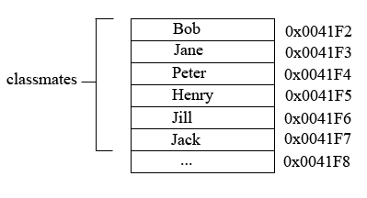
How arrays are stored in the memory
Reference data type
Variable “classmates” holds addresses in the heap as values.
Each address points to a separate value in the heap memory.

Slide 7
Working with Arrays in Java
Allocating an array of 10 integers:
Assigning values to the array elements:
Accessing array elements by index:
int[] numbers = new int[10];
for (int i=0; i<numbers.length; i++)
numbers[i] = i+1;
numbers[3] = 20;
numbers[5] = numbers[2] + numbers[7];

Slide 8
Arrays of Strings
You may define an array of any type, e.g. String:
String[] names = { "Peter", "Maria", "Katya", "Todor" };
for (int i = 0; i<names.length; i++) {
System.out.printf("names[%d] = %s\n", i, names[i]);
}
for (String name : names) {
System.out.println(name);
}
names[4] = "Nakov"; // ArrayIndexOutOfBoundsException
names.length = 5; // array.length is read-only field

Slide 9
Read, Sort and Print Array of n Strings
Scanner scanner = new Scanner(System.in);
int n = scanner.nextInt();
scanner.nextLine();
String[] lines = new String[n];
for (int i = 0; i < n; i++) {
lines[i] = scanner.nextLine();
}
Arrays.sort(lines);
for (int i = 0; i < lines.length; i++) {
System.out.println(lines[i]);
}

Slide 10

Arrays
Live Demo

Slide 11
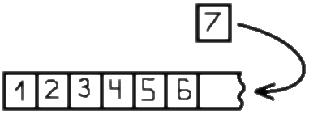
Lists
Using ArrayList<E>

Slide 12
Lists in Java
In Java arrays have fixed length
Cannot add / remove / insert elements
Lists are like resizable arrays
Allow add / remove / insert of elements
Lists in Java are defined through the ArrayList<E> class
Where E is the type of the list, e.g. String or Integer
ArrayList<Integer> numbers = new ArrayList<Integer>();
numbers.add(5);
System.out.println(numbers.get(0)); // 5

Slide 13
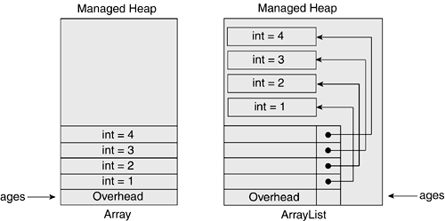
How array lists are stored in the memory
Reference data type
Variable “ages” holds pointers to Objects in the heap as values.
Each Object has an address that points to a value in the memory.
Future reference
Arrays vs ArrayLists

Slide 14
ArrayList<String> – Example
ArrayList<String> names = new ArrayList<String>() {{
add("Peter");
add("Maria");
add("Katya");
add("Todor");
}};
names.add("Nakov"); // Peter, Maria, Katya, Todor, Nakov
names.remove(0); // Maria, Katya, Todor, Nakov
names.remove(1); // Maria, Todor, Nakov
names.remove("Todor"); // Maria, Nakov
names.addAll(Arrays.asList("Alice", "Tedy"));
// Maria, Nakov, Alice, Tedy
names.add(3, "Sylvia"); // Maria, Nakov, Alice, Sylvia, Tedy
names.set(2, "Mike"); // Maria, Nakov, Mike, Sylvia, Tedy
System.out.println(names);

Slide 15
ArrayList<Integer> – Example
// This will not compile!
ArrayList<int> intArr = new ArrayList<int>();
ArrayList<Integer> nums = new ArrayList<>(
Arrays.asList(5, -3, 10, 25));
nums.add(55); // 5, -3, 10, 25, 55
System.out.println(nums.get(0)); // 5
System.out.println(nums); // [5, -3, 10, 25, 55]
nums.remove(2); // 5, -3, 25, 55
nums.set(0, 101); // 101, -3, 25, 55
System.out.println(nums); // [101, -3, 25, 55]

Slide 16


ArrayList<E>
Live Demo

Slide 17

Strings
Basic String Operations

Slide 18
What Is String?
Strings are indexed sequences of Unicode characters
Represented by the String class in Java
Characters accessed by index: 0 … length()-1
Example:
string s = "Hello, SoftUni!";
s
H | e | l | l | o | , |  | S | o | f | t | U | n | i | !
0 1 2 3 4 5 6 7 8 9 10 11 12 13 14

Slide 19
Working with Strings
Strings in Java
Know their number of characters: length()
Can be accessed by index: charAt(0 … length()-1)
Reference types
Stored in the heap (dynamic memory)
Can have null value (missing value)
Strings cannot be modified (immutable)
Most string operations return a new String instance
StringBuilder class is used to build stings

Slide 20
Strings – Examples
String str = "SoftUni";
System.out.println(str);
for (int i = 0; i < str.length(); i++) {
System.out.printf("str[%d] = %s\n", i, str.charAt(i));
}
System.out.println(str.indexOf("Uni")); // 4
System.out.println(str.indexOf("uni")); // -1 (not found)
System.out.println(str.substring(4, 7)); // Uni
System.out.println(str.replace("Soft", "Hard")); // HardUni
System.out.println(str.toLowerCase()); // softuni
System.out.println(str.toUpperCase()); // SOFTUNI

Slide 21
Strings – Examples (2)
String firstName = "Steve";
String lastName = "Jobs";
int age = 56;
System.out.println(firstName + " " + lastName +
" (age: " + age + ")"); // Steve Jobs (age: 56)
String allLangs = "C#, Java; HTML, CSS; PHP, SQL";
String[] langs = allLangs.split("[, ;]+");
for (String lang : langs) {
System.out.println(lang);
}
System.out.println("Langs = " + String.join(", ", langs));
System.out.println(" \n\n Software University ".trim());

Slide 22
Comparing Strings in Java
The == operator does not work correctly for strings!
Use String.equals(String) and String.compareTo(String)
String[] words = "yes yes".split(" ");
System.out.println("words[0] = " + words[0]); // yes
System.out.println("words[1] = " + words[0]); // yes
System.out.println(words[0] == words[1]); // false
System.out.println(words[0].equals(words[1])); // true
System.out.println("Alice".compareTo("Mike")); // < 0
System.out.println("Alice".compareTo("Alice")); // == 0
System.out.println("Mike".compareTo("Alice")); // > 0

Slide 23
Regular Expressions
Regular expressions match text by pattern, e.g.
[0-9]+ matches a non-empty sequence of digits
[a-zA-Z]* matches a sequence of letters (including empty)
[A-Z][a-z]+ [A-Z][a-z]+ matches a name (first name + space + last name)
\s+ matches any whitespace; \S+ matches non-whitespace
\d+ matches digits; \D+ matches non-digits
\w+ matches letters (Unicode); \W+ matches non-letters
\+\d{1,3}([ -]*[0-9]+)+ matches international phone

Slide 24
Validation by Regular Expression – Example
import java.util.regex.*;
…
String regex = "\\+\\d{1,3}([ -]*[0-9]+)+";
System.out.println("+359 2 981-981".matches(regex)); // true
System.out.println("invalid number".matches(regex)); // false
System.out.println("+359 123-".matches(regex)); // false
System.out.println("+359 (2) 981 981".matches(regex)); // false
System.out.println("+44 280 11 11".matches(regex)); // true
System.out.println("++44 280 11 11".matches(regex)); // false
System.out.println("(+49) 325 908 44".matches(regex)); // false
System.out.println("+49 325 908-40-40".matches(regex)); // true

Slide 25
Find Matches by Pattern – Example
import java.util.regex.*;
…
String text =
"Hello, my number in Sofia is +359 894 11 22 33, " +
"but in Munich my number is +49 89 975-99222.";
Pattern phonePattern = Pattern.compile(
"\\+\\d{1,3}([ -]*([0-9]+))+");
Matcher matcher = phonePattern.matcher(text);
while (matcher.find()) {
System.out.println(matcher.group());
}
// +359 894 11 22 33
// +49 89 975-99222

Slide 26
Strings
Live Demos

Slide 27
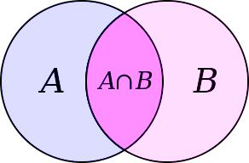
Sets
HashSet<E> and TreeSet<E>

Slide 28
Sets in Java
Sets in Java keep unique elements
Like lists but duplicated elements are stored only once
HashSet<E>
Keeps a set of elements in a hash-tables
The elements are randomly ordered (by their hash code)
TreeSet<E>
Keeps a set of elements in a red-black ordered search tree
The elements are ordered incrementally

Slide 29
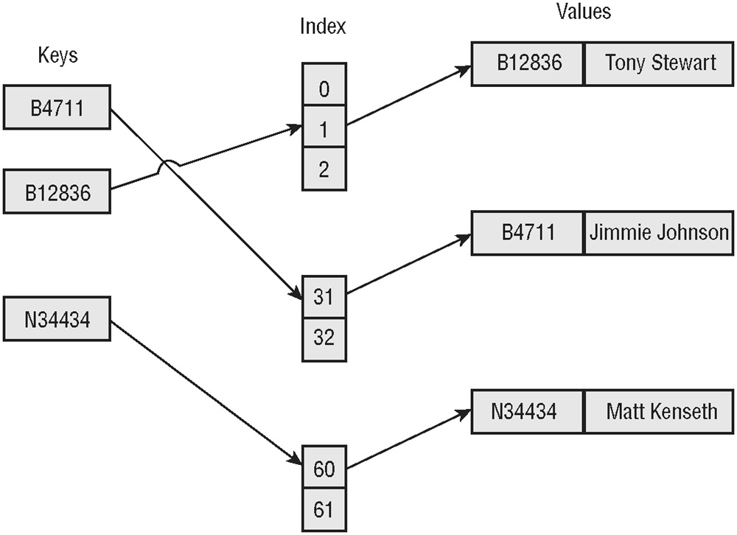
How hash sets are stored in the memory
Reference data type
Variable “names” holds hash indexes that point to Objects in the heap as values.
Each Object has an address that points to a value in the memory.
Future Reference
HashSet
TreeSet

Slide 30
HashSet<E> and TreeSet<E> – Examples
Set<String> set = new TreeSet<String>();
set.add("Pesho");
set.add("Tosho");
set.add("Pesho");
set.add("Gosho");
set.add("Maria");
set.add("Alice");
set.remove("Pesho");
System.out.println(set); // [Alice, Gosho, Maria, Tosho]

Slide 31
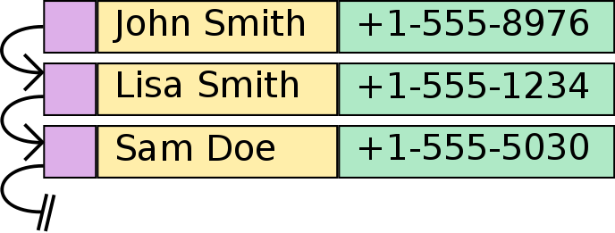
Maps

Slide 32
Maps in Java
Maps in Java keep unique <key, value> pairs
HashMap<K, V>
Keeps a map of elements in a hash-table
The elements are randomly ordered (by their hash code)
TreeMap<K, V>
Keeps a set of elements in a red-black ordered search tree
The elements are ordered incrementally by their key

Slide 33
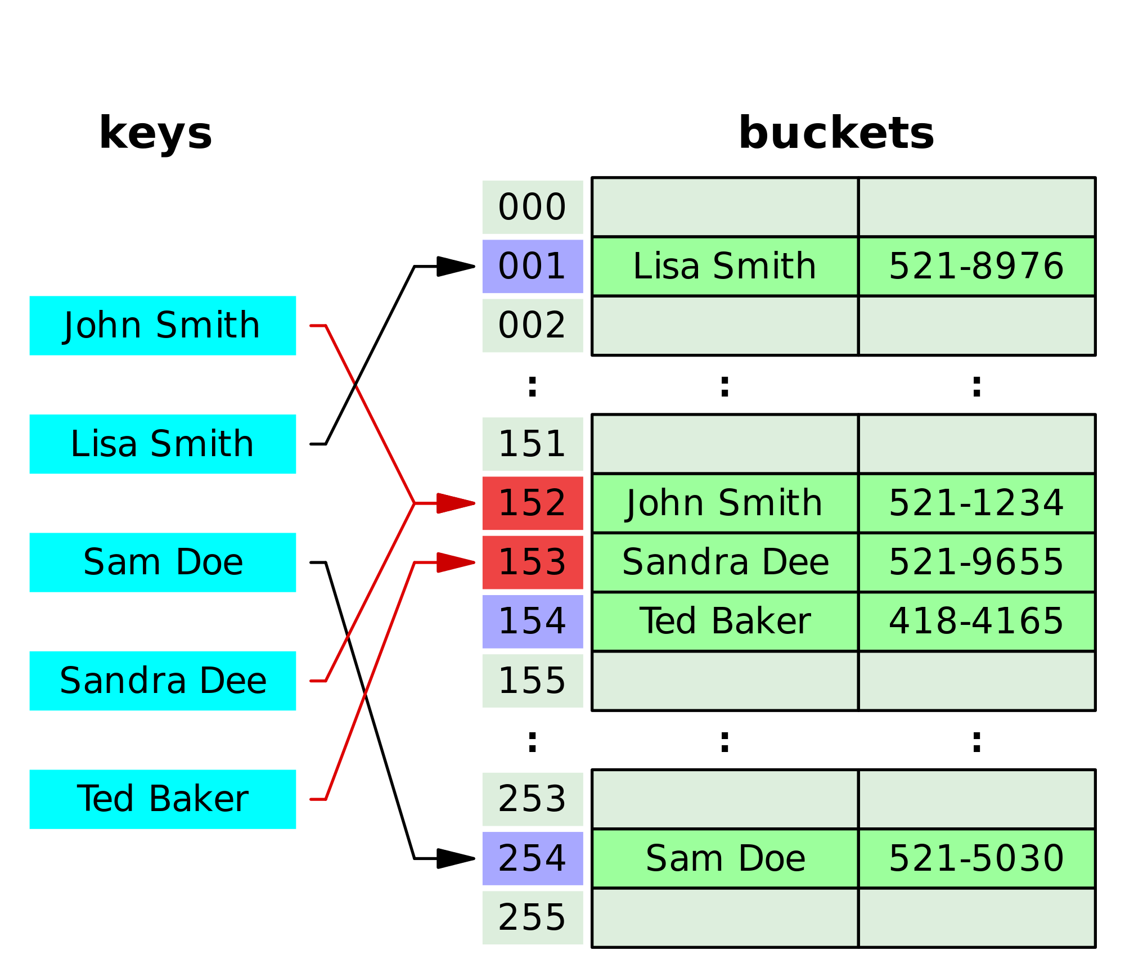
How hash maps are stored in the memory
Reference data type
Variable “phonebook” holds hash indexes that point to keys in the heap as values.
Each key points to a value in the memory.

Slide 34
HashMap<K, V> – Examples
Counting words occurrences in a list:
String[] words = { "yes", "hi", "hello", "hi", "welcome",
"yes", "yes", "welcome", "hi", "yes", "hello", "yes" };
Map<String, Integer> wordsCount = new HashMap<String, Integer>();
for (String word : words) {
Integer count = wordsCount.get(word);
if (count == null) {
count = 0;
}
wordsCount.put(word, count+1);
}
System.out.println(wordsCount); // {hi=3, yes=5, hello=2, welcome=2}

Slide 35
TreeMap<K, V> – Examples
Students and their grades
HashMap<String, ArrayList<Integer>> grades = new HashMap<>();
grades.put("Peter", new ArrayList<>(Arrays.asList(5)));
grades.put("George", new ArrayList<>(Arrays.asList(5, 5, 6)));
grades.put("Maria", new ArrayList<>(Arrays.asList(5, 4, 4)));
grades.get("Peter").add(6);
grades.get("George").add(6);
for (String key : grades.keySet()) {
System.out.println("" + key + " -> " + grades.get(key));
}

Slide 36
Future References
Java Oracle documentation - http://docs.oracle.com/javase/tutorial/collections/index.html
The book “Java Generics and Collections” - http://www.amazon.com/dp/0596527756/

Slide 37

Summary
Arrays, Strings and Collections:
Arrays: int[], String[], etc.
Strings: String str = "Hello";
Lists: ArrayList<E>
Sets: HashSet<E>, TreeSet<E>
Maps: HashMap<K, V>, TreeMap<K, V>

Slide 38










Java Collections Basics
https://softuni.bg/courses/java-basics/

Slide 39
License
This course (slides, examples, demos, videos, homework, etc.) is licensed under the "Creative Commons Attribution-NonCommercial-ShareAlike 4.0 International" license
Attribution: this work may contain portions from
"Fundamentals of Computer Programming with Java" book by Svetlin Nakov & Co. under CC-BY-SA license
"C# Basics" course by Software University under CC-BY-NC-SA license

Slide 40





Free Trainings @ Software University
Software University Foundation – softuni.org
Software University – High-Quality Education, Profession and Job for Software Developers
softuni.bg
Software University @ Facebook
facebook.com/SoftwareUniversity
Software University @ YouTube
youtube.com/SoftwareUniversity
Software University Forums – forum.softuni.bg

